Slide 1
Introduction to Angular
Henrik Høltzer / Webprogramming 2017 Source: angular.io

Slide 2
What is Angular ?
Angular is a platform that helps you create advanced web applications in HTML using Typescript (Dart or ES5).
It helps you to structure your code, separate your concerns and remove trivial code.

Slide 3
Angular Modularity
Angular applications are based on Modules.
Angular Modules helps organizing the application into cohesive blocks of functionality.
A module is implemented as a class.
Declares which components, services etc that belongs together.

Slide 4
Angular AppModule
Every Angular applications have at least one module - the RootModule by convention named AppModule.
Larger Angular applications will have feature and route modules as well.

Slide 5
Angular AppModule
Live example: HelloAngular

Slide 6
Angular Architecture

Slide 7
Angular Architecture
The architecture diagram identifies the eight main building blocks of an Angular application:
Modules
Components
Templates
Metadata
Data binding
Directives
Services
Dependency injection

Slide 8
Angular Components
A component controls a piece of the screen called a view.
A component's application logic—what it does to support the view—is defined in a class. The class interacts with the view through an API of properties and methods.

Slide 9
Angular Components
A component consists of tree parts:
A Template
A Decorator
A TypeScript class
Live example: Tour of Heroes

Slide 10
Template
You define a component's view with its companion template.
A template is a form of HTML that tells Angular how to render the component.

Slide 11
Template

Slide 12
Metadata
Metadata tells Angular how to process a class.
To tell Angular that it’s a component, attach metadata to the class. In TypeScript, you attach metadata by using a decorator

Slide 13
Component class
Plain old TypeScript object
Exposes properties and method to be used in the template

Slide 14
Template – Data binding
Without a framework, you would be responsible for pushing data values into the HTML controls and turning user responses into actions and value updates.
Angular supports data binding, a mechanism for coordinating parts of a template with parts of a component.

Slide 15
Template – Data binding

Slide 16
Template – Data binding

Slide 17
Template – Data binding
Data binding plays an important role in communication between a template and its component.
But data binding is also important for communication between parent and child components.

Slide 18
Directives
Angular templates are dynamic. When Angular renders them, it transforms the DOM according to the instructions given by directives.
A directive is a class with a @Directive decorator. A component is a directive-with-a-template; a @Component decorator is actually a @Directive decorator extended with template-oriented features.
Two other kinds of directives exist: structural and attribute directives.

Slide 19
Directives - Structural
Structural directives alter layout by adding, removing, and replacing elements in DOM.

Slide 20
Directives - Attribute
Attribute directives alter the appearance or behavior of an existing element. In templates they look like regular HTML attributes, hence the name.
Live example: Tour of Heroes – Multiple components

Slide 21
Services
Service is a broad category encompassing any value, function, or feature that your application needs.
Almost anything can be a service. A service is typically a TypeScript class with a narrow, well-defined purpose, but can just as well be a function or value
Services should contain the business logic – not the component.

Slide 22
Services
There is nothing specifically Angular about services. Angular has no definition of a service. There is no service base class, and no place to register a service.
Component classes should be lean. They don't fetch data from the server, validate user input, or log directly to the console. They delegate such tasks to services. A component's job is to enable the user experience and nothing more. It mediates between the view (rendered by the template) and the application logic (which often includes some notion of a model). A good component presents properties and methods for data binding. It delegates everything nontrivial to services.

Slide 23
Services
Here's an example of a service class that logs to the browser console:

Slide 24
Dependency Injection
Dependency injection is a way to supply a new instance of a class with the dependencies it requires. Most dependencies are services.
Angular uses dependency injection to provide new components with the services they need.
Angular can tell which services a component needs by looking at the types of its constructor parameters.

Slide 25
Dependency Injection
When Angular creates a component, it first asks an injector for the services that the component requires.
An injector maintains a container of service instances that it has previously created. If a requested service instance is not in the container, the injector makes one and adds it to the container before returning the service to Angular. When all requested services have been resolved and returned, Angular can call the component's constructor with those services as arguments. This is dependency injection.

Slide 26
Injector & Providers
We must register a service provider with the injector, otherwise it don’t know how to create the service.
A provider is something that can create or return a service, typically the service class itself.
You can register providers in modules or in components.

Slide 27
Injector & Providers
In general, add providers to the AppModule (root module) so that the same instance of a service is available everywhere.

Slide 28
Injector & Providers
Alternatively, register at a component level in the providers property of the @Component metadata:
Registering at a component level means you get a new instance of the service with each new instance of that component, and you hides the provider from other components and modules.
Live example: Tour of Heroes - Services

Slide 29
Input & Output
Component interaction
Passing data from parent to child using: @Input( ) and property-binding Passing data from child to parent using: @Output( ) , EventEmitter and event-binding (The parent listens for child event)

Slide 30
Parent to child - @Input()
ParentComponent
ChildComponent
parentProperty : T
@Input( ) childProperty : T
<child-component [childProperty] = ”parentProperty”><child…..
<p> {{childProperty }} </p>
Property-binding in parents html:
[childProperty] = ”parentProperty”

Slide 31
Child to parent - @Output()
ParentComponent
ChildComponent
parentProperty : T
@Output( ) eventEmitter = new EventEmitter<T>()
eventHandler (fromChild : T) {this. parentProperty=fromChild;}
someMethod(value : T ){this.eventEmitter.emit(value)}
<child-component (eventEmitter) = ”eventHandler($event)” ><child…..
<p> (someEvent)=”someMethod(‘someValue’)” </p>
Event-binding in parents html in the child-selector:
(eventEmitter) = ”eventHandler($event)”
Event-binding in child html:
(someEvent)=”someMethod(‘someValue’)”

Slide 32
@Input() - @Output()
Don’t forget the imports !
import { Component, Output, EventEmitter } from '@angular/core';
import { Component, Input } from '@angular/core';

Slide 33
Routing & navigation
The browser is a familiar model of application navigation:
Enter a URL in the address bar and the browser navigates to a corresponding page.
Click links on the page and the browser navigates to a new page.
Click the browser's back and forward buttons and the browser navigates backward and forward through the history of pages you've seen. The Angular Router ("the router") borrows from this model.

Slide 34
Routing & navigation
Routing is not a part of the core package, but: @angular/router eg. import { RouterModule, Routes } from '@angular/router';
A route describes a relation between the URL and a component eg. http://localhost:4500/movie-list
{ path: 'movie-list', component: MovieListComponent },

Slide 35
The router module
The RouterModule is not imported in the root module, we create and import our own module. const appRoutes: Routes = [ { path: 'movie-list', component: MovieListComponent }, { path: 'movie-detail/:Title', component: MovieDetailComponent }, …
@NgModule({ imports: [ CommonModule, RouterModule.forRoot(appRoutes)], exports: [ RouterModule ], …

Slide 36
Import the router module
The configured router module is imported into the AppModule. @NgModule({
declarations: [ AppComponent, MovieListComponent, … ],
imports: [ BrowserModule, FormsModule, HttpModule, AppRouterModule ],
Feature modules can (should) have routing as well. Then we use RouteModule.forChild(… ) (instead of forRoot(… ))

Slide 37
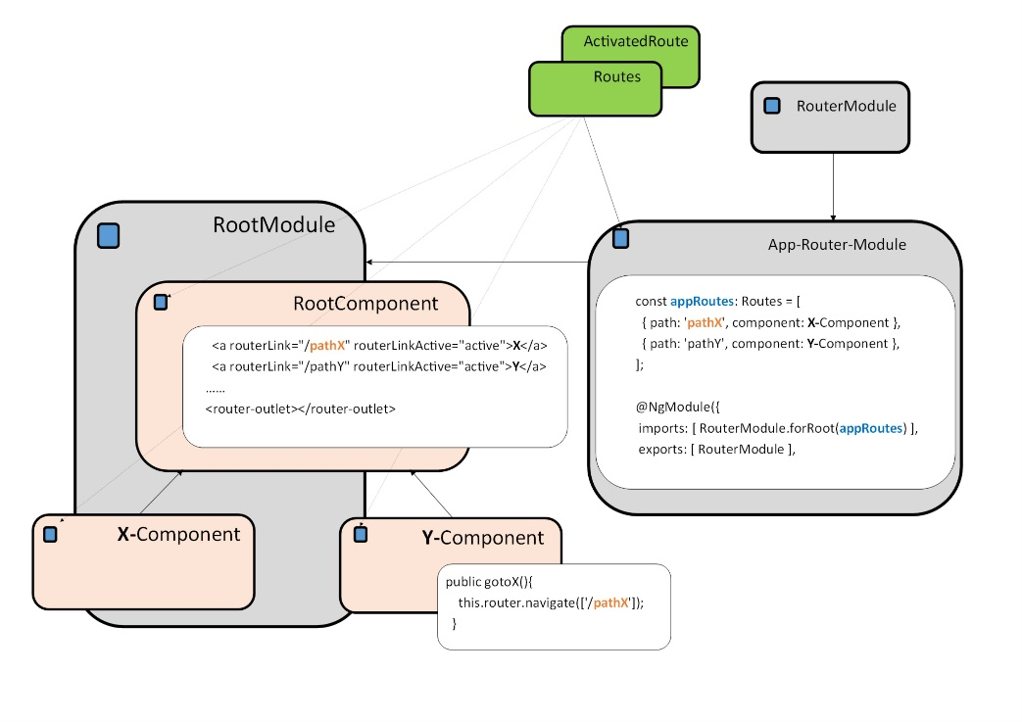
RouterModule - Overview

Slide 38
Navigating
Navigate programmatically (imperatively) by injecting the Router via the constructor: constructor(private movieService : MovieService,
private route: ActivatedRoute,
private router: Router) { },
and call the router.navigate method: public gotoMovies(){ this.router.navigate(['/movie-list']); }

Slide 39
Navigating
Navigate using the routerLink attribute directive in the template: <nav class="nav navbar-nav"> <a routerLink="/movie-list" routerLinkActive="active">Movies</a>
<a routerLink="/under-construction" routerLinkActive="active">Admin</a> ……….
</nav>
The router displays each component immediately below the <router-outlet></router-outlet> as we navigate through the application : <div class="container"> <router-outlet></router-outlet> </div>

Slide 40
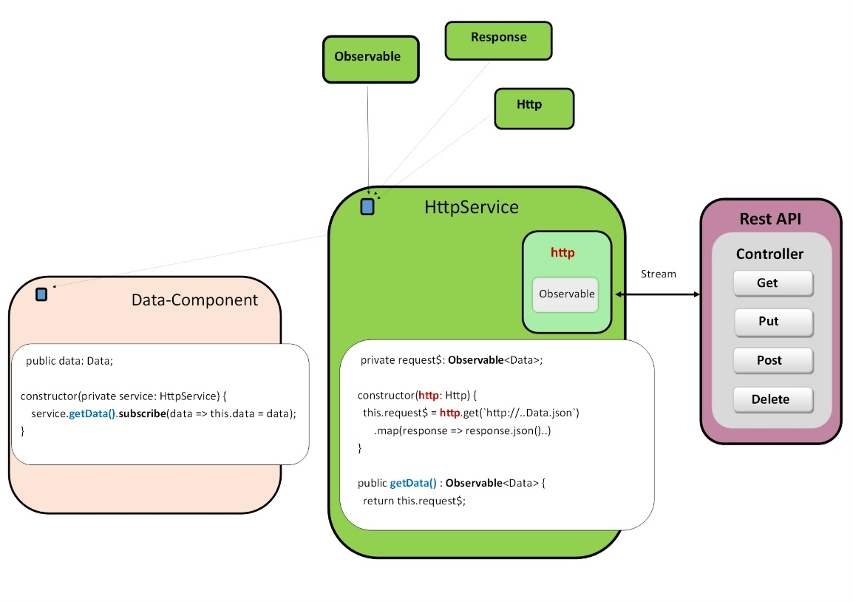
HttpService

